Slide 1
Privacy Preserving Federated Matrix Factorization for Recommendation Systems
Course: Privacy Preserving Machine Learning, Lecturer: Dr. Adi Akavia ,Written by: Shir Sneh
August 2023

Slide 2
Intro
Recommendation systems are used to provide users with personalized suggestions and recommendations that help them discover relevant items, content, products, and services. These systems are widely used in many industries and applications, including e-commerce, streaming platforms, social media, and content websites.
As those systems become more popular and used more frequently, security concerns arise.
Privacy-preserving recommendation systems strive to balance the need for personalized recommendations with user privacy and security. By adopting a decentralized approach, federated recommendation systems address these concerns. In this context, "federated" refers to the collaboration of multiple entities, such as devices, servers, or users, to collectively generate recommendations without sharing raw data.

Slide 3
The proposed system
The recommendation system proposed here adopts a privacy-preserving federated approach. It incorporates matrix factorization and Paillier encryption to provide users with personalized song recommendations while maintaining their privacy. The primary aim is to deliver song suggestions that align with the user's preferences while upholding the security of their private data.

Slide 4
Preliminaries

Slide 5
Federated Learning
Federated learning is a unique machine learning paradigm where multiple clients, such as users or devices, collaborate to train a model while retaining their local datasets. The central server aggregates updates from individual datasets to create a global model, subsequently shared with clients for local refinements. This approach ensures data privacy as raw data remains confined to clients' devices, eliminating the need for transmission.
By adopting this method, organizations can tap into distributed data's potential while maintaining privacy. Each client contributes to model enhancement without exposing raw data to external parties, safeguarding user privacy and enabling robust model creation through diverse data sources.

Slide 6
Matrix Factorization
Matrix Factorization stands as a widely used method within recommendation systems. It involves breaking down a matrix that represents user-item interactions into two matrices of lower rank. These are often called the user and item matrices.
In more detail, the user matrix encapsulates latent features associated with users, while the item matrix does the same for items. These latent features could encompass various attributes or characteristics that are not explicitly captured in the original data.
The true power of matrix factorization emerges when it comes to making predictions. By taking the dot product of the latent feature vectors from the user and item matrices, it becomes possible to predict the interaction or preference of a user for a particular item. This means that even if explicit interactions between certain users and items are missing in the original data, the model can make educated guesses based on the inferred latent features.

Slide 7
Homomorphic Encryption
Homomorphic encryption represents an encryption method that possesses a unique capability: it enables computations to be executed on encrypted data, producing an encrypted outcome. Once decrypted, this outcome matches the result of the corresponding operations conducted on the original, unencrypted data.
Essentially, homomorphic encryption enables us to work with sensitive data while maintaining its confidentiality. It's a crucial aspect of our approach, allowing us to perform intricate computations without the need to decrypt the data at any point during the process.

Slide 8
Paillier Encryption
The Paillier cryptosystem operates as a public-key encryption method that possesses distinctive homomorphic attributes. In particular, it facilitates the addition of two encrypted numbers, a concept referred to as homomorphic addition. Additionally, it enables the multiplication of an encrypted number with a non-encrypted counterpart, known as homomorphic multiplication.
These homomorphic properties hold significant implications. They grant us the ability to carry out computations on encrypted data without the need for decryption. To elaborate, consider the scenario of homomorphic addition: we can add two encrypted numbers together, and upon decryption, the result matches the sum of the respective original numbers. Similarly, in the case of homomorphic multiplication, the product of an encrypted number and a non-encrypted number, when decrypted, corresponds to what would be obtained by multiplying the two original numbers.
This capability holds immense significance for our purpose of providing recommendations based on matrix factorization. It empowers us to conduct complex operations on sensitive, encrypted data while maintaining the confidentiality of the actual information. In essence, we can manipulate encrypted data to extract valuable insights without compromising the privacy and security of the raw data.

Slide 9
Algorithm

Slide 10
Description
The architecture of the privacy-preserving federated matrix factorization recommendation system consists of various integral components: the User, Server, GUIApp classes, and the calculation functions.
The User class embodies system users, encompassing both their actual and predicted ratings. It includes a binary mask that signifies their rated items, user identification, encrypted password, learning rate, as well as private and public keys. This class also features a method for updating user ratings.
The Server class functions as the central server within the federated learning framework. It encompasses item profiles, a learning rate, user count, and a public key. This class includes a method for updating these profiles based on user gradients.
The GUIApp class takes charge of the user interface, offering functions for user management such as login and signup. It also provides functions for data management, including loading data onto the screen and updating it as necessary.
The calculation functions consist of essential matrix factorization calculations, such as update_matrices, compute_gradient, and compute_loss. The pivotal function, update_matrices, orchestrates the iterative process involving gradient computation and updates. This process continues until convergence, as determined by a threshold reflecting the change in total loss.

Slide 11
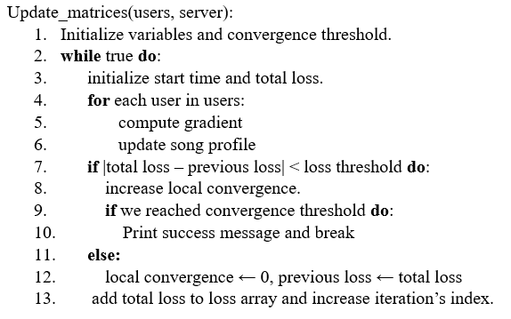
Pseudocode

Slide 12
use case example

Slide 13
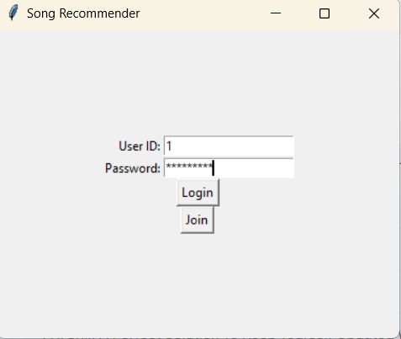
Figure 1: Login screen

Slide 14
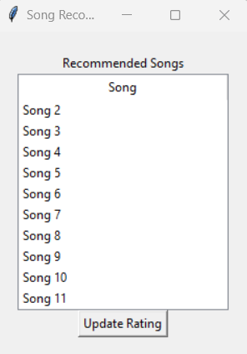
Figure 2: Recommendation Screen

Slide 15
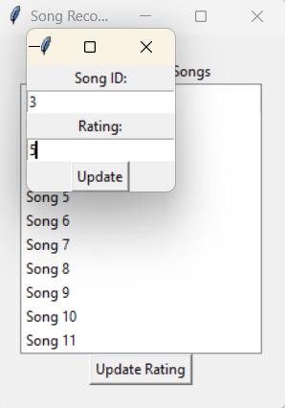
Figure 3: Updating Rating

Slide 16
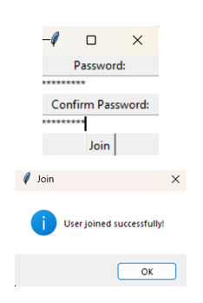
Figure 4: Adding a new user

Slide 17
Conclusion
My executed model effectively showcased the algorithm's prowess in furnishing precise recommendations without compromising user privacy. Nevertheless, there exist opportunities for refinement, including the exploration of alternative privacy methods to tackle the issue of information leakage associated with the disclosure of Model Convergence Details.

